Slide 1


SMART PARKING MANAGEMENT SYSTE
DEPARTMENT OF ELECTRONICS AND COMMUNICATION ENGINEERING
USING ARDUINO
A MAJOR PROJECT PRESENTATION
ON
SMART PARKING MANAGEMENT SYSTEM
M.SHIVALEELA
T.PRIYANKA
L.PRAVEEN S.SANJAY
-22681A0438
-23685A0414
Guide:
Mr.SAJJAN
(Assist prof)
-22681A0434
-23685A0413

Slide 2
Abstract:
This paper proposes the smart parking management system that depends on Arduino parts, android applications. with growing, car parking increases with the number of car users. In urban areas, finding a parking spot can be frustrating. The smart parking management (SPMS)is aims to solve this issue by using advanced technology this system includes sensors placed in each parking space to detect whether its occupied or free. The data from these sensors is sent to a central server that processes it in real-time.
It allows users to reserve parking spaces of time by alerting they have a spot when they arrive. By providing real-time alerts and reservation capabilities the system improves the efficiency of urban parking. This integration of smart technologies into parking management represents a significant step toward smarter and more efficient urban infrastructure .

Slide 3
Introduction:
Efficiently manages parking spaces using IoT and sensors
Provides real-time availability of parking spots
Reduces traffic congestion and vehicle idling time
Saves fuel and minimizes environmental pollution
Allows digital payments and automated ticketing
Enhances user convenience through mobile apps
Helps in data collection and monitoring for smart city planning

Slide 4
BLOCK DIAGRAM:
POWER SUPPLY
ESP32
Microcontroller
SERVO MOTOR
IR SENSOR(1)
IR SENSOR(2)
OLED
IR SENSOR(3)

Slide 5
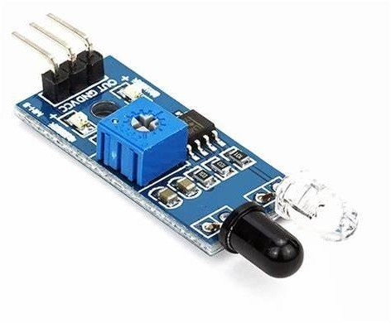
MAJOR COMPONENTS:
1.IR Sensor:
An IR sensor is an electronic device that detects infrared radiation (heat) emitted by objects.
It can sense motion, proximity, and temperature without physical contact.
Used for motion detection.
Range: Up to 20 cm
Types:
Active IR sensors: Use both emitter and receiver to detect reflected IR light.
Passive IR sensors (PIR): Detect infrared radiation from warm objects like humans or animals.

Slide 6
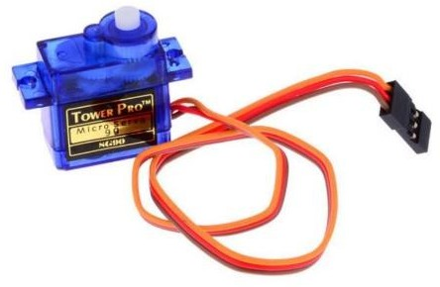
2.Servo Motor:
A servo motor is a small motor that can turn to a specific angle.
It receives a signal telling it what angle to move to, and it adjusts itself using feedback.
uses:
Robotics
Smart parking gates
Camera pan/tilt
Remote-controlled cars

Slide 7
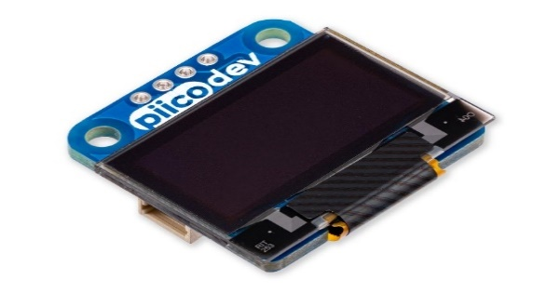
3.OLED:
OLED stands for Organic Light-Emitting Diode. It’s a type of screen where each tiny dot (called a pixel) makes its own light. That means the screen doesn’t need a backlight like older displays. Because of this, OLED screens can be super thin,bright colors use less power
Uses:
Smartphones
Smartwatches
4.ESP32-Microcontroller:
ESP32 is a low-cost, powerful microcontroller with built-in Wi-Fi and Bluetooth capabilities. It’s made by Espressif Systems and is widely used in IoT (Internet of Things) projects, smart devices, and automation systems. It has a dual-core processor, multiple input/output pins, and supports various sensors and modules

Slide 8
Working principle:
A Smart Parking Management System operates by integrating sensors, communication networks, and software applications to optimize the use of parking spaces in real time. The system begins with the installation of sensors in individual parking spots, which detect the presence or absence of vehicles. These sensors transmit data to a central server via wireless communication technologies such as Wi-Fi, LoRaWAN, or cellular networks. The server processes this data and updates the availability status of each parking space.
Automated Payment
Payment is handled digitally via the app or contactless terminals.
Options include pay-per-use, subscription, or dynamic pricing based on demand.

Slide 9
.
User Interaction
Drivers use a smartphone app or kiosk to:
  Search for nearby available parking
  Reserve a spot in advance
  Navigate to the location using integrated maps
Environmental Impact
Reduces traffic congestion and fuel consumption by minimizing the time spent searching for parking

Slide 10
Advantages:
Smart parking
Real-time parking data
Automated parking system
Parking reservation
Mobile parking app
Cloud-based parking
Vehicle detection

Slide 11
Applications:
GPS tracking
Cloud computing
Mobile app integration
Real-time data
Wireless communication
Automated systems
Smart meters
Data analytics

Slide 12
Future Scope:
Work with Smart Cities: It will connect with traffic lights, buses, and trains to make travel smoother.
Help Self-Driving Cars: Smart parking will guide driverless cars to park themselves safely.
Car-to-Parking Communication
Your car will talk directly to parking systems to find and reserve a
spot automatically.
Global Parking Networks
You’ll use one app to find parking in any city or country.
No need to download different apps when you travel.

Slide 13
Conclution
Smart Parking Management Systems make parking faster, easier, and smarter. They help drivers find empty spots quickly, save time and fuel, and reduce traffic jams. With mobile apps and sensors, everything becomes automatic—from finding a space to paying for it. In the future, smart parking will work with self-driving cars, electric vehicles, and smart cities to make life even better. It's a smart solution for busy places and a cleaner, safer future.

Slide 14


